Slide 1
AZ-300T06 M 2: Configuring a Message-Based Integration Architecture
Configure an app or service to send emails
Configure an event publish and subscribe model
Configure the Azure Relay service
Create and configure a notification hub
Create and configure an event hub
Notes:
AZ-300.17 Module 17: Configuring a Message-Based Integration Architecture

Slide 2
Lesson 1: Configure an app or service to send emails
SendGrid
Sending emails through SendGrid by using C#

Slide 3
SendGrid
A third party, cloud-based messaging service, which offers:
deep level of integration with the Azure platform and the Azure portal
transactional email delivery
scalability based on email volume
real-time analytics
a flexible API to enable custom integration scenarios.

Slide 4
Sending emails through SendGrid by using C#
Based on an open source library:
Hosted on GitHub at https://github.com/sendgrid/sendgrid-csharp
Available as a NuGet package
Implementation steps:
Create a new instance of the SendGridClient class
Pass a string parameter containing API Key
Use class methods to perform common tasks:
SendGridClient.SendEmailAsync to send a simple email
AddAttachment to attach a file to an email message

Slide 5
Lesson 2: Configure an event publish and subscribe model
Event-driven architecture
Azure Event Grid
Subscribing to Blob storage events using Azure CLI

Slide 6
Event-driven architecture
Consists of event producers and event consumers:
Facilitates processing of events in near-real time
Decouples producers from consumers
Decouples consumers from each other
Allows all consumers to see all events
Offers several Azure-based implementations:
Simple event processing: Each event triggers immediately an action in a consumer:
e.g. Azure Functions with an Azure Service Bus trigger
Complex event processing: Consumers process a series of events, looking for patterns:
e.g. Azure Stream Analytics or Apache Storm
Event stream processing: A stream processor processes or transform the stream:
e.g. Azure IoT Hub or Apache Kafka

Slide 7
Lesson 3: Configure the Azure Relay service
Event-driven architecture
Azure Event Grid
Subscribing to Blob storage events using Azure CLI

Slide 8
Azure Relay service
Facilitates hybrid connectivity:
Securely connects public cloud to services within a corporate enterprise network
Eliminates the need to open inbound firewall ports or change network infrastructure
Uses an outbound port to establish bidirectional socket dedicated to an internal service
Supports a variety of connectivity scenarios:
Traditional one-way, request/response and peer-to-peer traffic
Event distribution to enable publish/subscribe scenarios
Bidirectional socket communication
Offers the Hybrid Connections capability, which additionally supports:
WebSocket protocol
HTTP and HTTPs requests and responses

Slide 9
Azure Relay service architecture
An Azure load balancer: routes requests to any of the gateway nodes.
Gateway nodes: create new relays, forward connection requests to specific nodes that own a requested relays, and send rendezvous requests to listening clients.
Listening clients: create temporary channels to gateway nodes in response to rendezvous requests and exchange messages via the gateway node.
Communication flow:
A client (Client A) creates a listening request that is routed to a gateway.
The gateway creates a new relay.
A different client (Client B) creates a connection request.
The connection request from Client B is handled first by looking up the associated relay.
Once the correct relay has been identified, the request is forwarded to that specific relay.
A rendezvous request is sent to Client A.
Client A creates a temporary channel to Client B via the gateway that Client B used in its connection request.
Client B can receive messages from Client A directly from its original gateway.
Client A can receive messages from Client B via the original gateway and the established temporary channel.

Slide 10
Using Azure Relay in Node.js
Facilitated by:
Node.js ws package WebSocket protocol client library
Node.js hyco-ws package for Hybrid Connections in Azure Relay, which extends ws:
Adds a new server class exported via require(‘hyco-ws’).RelayedServer and a few helper methods
Provides hycows.RelayedServer class as an alternative to the ws.Server class. The RelayedServer constructor has two required arguments to establish a connection over the WebSocket protocol using Azure Relay:
server - The fully qualified URI for a Hybrid Connection name on which to listen.
token - Either a previously issued token string or a callback function that can be called to obtain such a token string.
Any libraries that support the WebSocket protocol in the language of your choice.

Slide 11
Lesson 4: Create and configure a notification hub
Azure Notification Hubs
Configuring Notification Hubs in iOS
Configuring Notification Hubs in Xamarin.Android
Sending messages from an application back end to Notification Hubs using C#

Slide 12
Azure Notification Hubs
A scaled-out push engine that:
Allows you to send notifications:
to practically any platform (iOS, Android, Windows, Kindle, BAIDU, etc.)
from practically any back end (cloud or on-premises).
Eliminates the complexity associated with implementing push notifications:
Offers multi-platform, scaled-out push notification infrastructure
Devices are responsible only for registering their PNS handles with a hub.
Facilitates a number of common notifications scenarios:
Sending breaking news notifications to millions with low latency
Sending location-based coupons to interested user segments
Sending event-related notifications for media/sports/finance/gaming applications
Pushing promotional content to applications to engage and market to customers
Notifying users of enterprise events, like new messages and work items
Sending codes for multi-factor authentication

Slide 13
Configuring Notification Hubs in iOS
Ensure that an Xcode application satisfies the following prerequisites:
The Push Notifications capability must be enabled.
The files distributed in the Azure messaging framework must be included in the project.
Implement the following steps:
add constants to HubInfo.h that will contain connection details for your notification hub
import the WindowsAzureMessaging/WindowsAzureMessaging and UserNotifications/UserNotifications directives into the project
add code to connect to the notification hub using the information stored in HubInfo.h

Slide 14
Configuring Notification Hubs in Xamarin.Android
Ensure that a Xamarin project satisfies the following prerequisites:
The Xamarin.GooglePlayServices.Base, Xamarin.Firebase.Messaging, and Xamarin.Azure.NotificationHubs.Android NuGet packages must be installed.
The google-services.json file must be downloaded from the Google Firebase Console and then copied to the root of your project folder.
com.google.firebase.iid.FirebaseInstanceIdReceiver receiver must be registered to enable PNS registration and message receipt.
Implement the following steps:
Add a C# class that will contain connection details for your notification hub
Create a C# class to manage PNS registration
Create a separate C# class to handle the receipt of a new message and display that message in the application’s UI

Slide 15
Sending messages from an application back end to Notification Hubs using C#
Available via a number of client libraries:
In .NET applications, the Microsoft.Azure.NotificationHubs NuGet package includes the NotificationHubClient class that can be used to send messages
Simplified by Azure Notification Hubs templates:
Allow you to specify how a device should receive notifications
Facilitate sending notifications to multiple platforms at the same time without having to specify a native payload

Slide 16
Lesson 5: Create and configure an event hub
Azure Event Hubs
Connecting Event Hubs to Stream Analytics
Azure IoT Hub

Slide 17
Azure Event Hubs
A big data streaming platform and event ingestion service:
Capable of receiving and processing millions of events per second
Facilitating processing and storing events, data, or telemetry produced by distributed software and devices
Providing low latency and seamless integration with data and analytics services inside and outside of Azure
Serving as an event ingestor in a pipeline between event producers and consumers
Consisting of the following main components:
Event producers
Partitions
Consumer groups
Throughput units
Event receivers

Slide 18
Connecting Event Hubs to Stream Analytics

Slide 19
Azure IoT Hub
A managed service operating as a central message hub:
Provides bidirectional communication between IoT application and IoT devices
Scales to millions of IoT devices of practically any type
Supports multiple messaging patterns, including:
device-to-cloud telemetry
file upload from devices
request-reply methods
Differs from Azure Event hubs in a number of aspects:
IoT Hub:
developed specifically to address the unique requirements of connecting IoT devices
includes features that enrich the relationship between IoT devices and back-end systems
Event Hubs:
designed for big data streaming
offer a partitioned consumer model to scale out stream and integrate with big data and analytics services

Slide 20
Module 17: Configuring a Message-Based Integration Architecture Lesson 07: Configuring apps and services with Microsoft Graph

Slide 21
Lesson 6: Managing Event Grid
Video: Event Grid Overview
Video: Implementing Event Grid
Overview of Event Grid
Event Grid Concepts
Event Grid Examples
Implementing Event Grid (Part 1)
Implementing Event Grid (Part 2)
Practice: Event Grid

Slide 22
Overview of Event Grid
Managed event routing service with a wide range of benefits:
Simplifies event delivery:
Connects multiple event sources and destinations, including virtually all Azure services and custom sources
Provides fully managed event delivery, intelligent filtering, and the ability to send events to multiple recipients at once
Eliminates polling and the associated cost and latency
Decouples event publishers from subscribers by using a pub/sub model and HTTP-based event delivery,
Simplifies building scalable serverless applications, microservices, and distributed systems.
Facilitates developing reliable cloud applications:
Supports massive auto-scaling with near-real-time notifications for changes
Implements reactive programming leveraging guaranteed event delivery
Promotes focus on product innovation

Slide 23
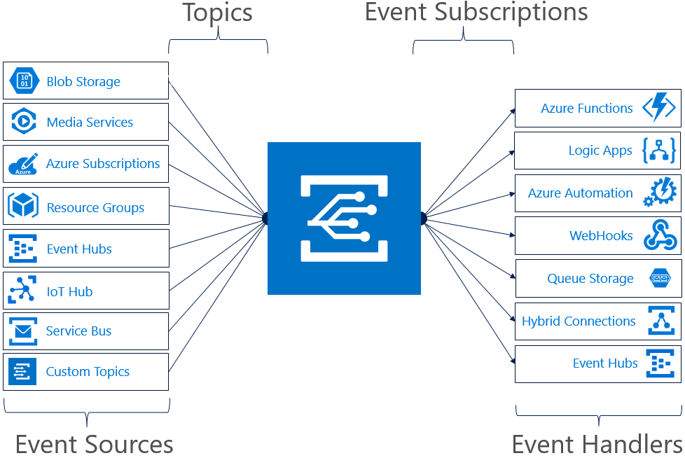
Event Grid Concepts
Event Sources
Topics
Event Subscriptions
Event Handlers

Slide 24
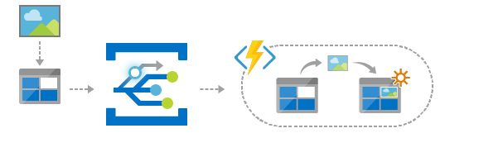
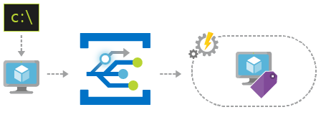
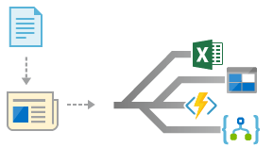
Event Grid Examples
Serverless application architecture
Ops automation
Application integration

Slide 25
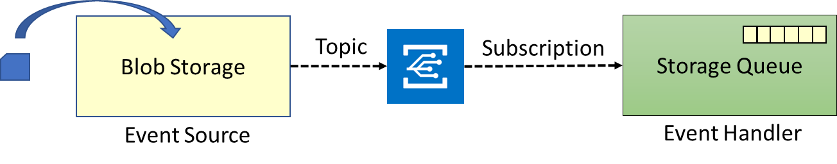
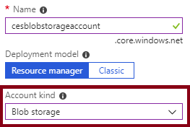
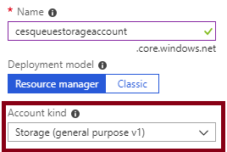
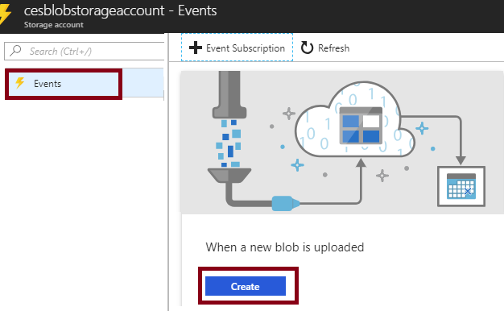
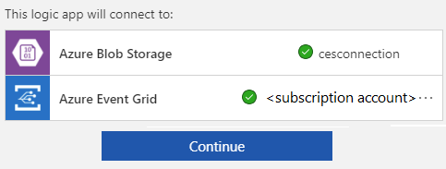
Implementing Event Grid (Part 1)
Implementation components:
Event source: Azure Blob Storage
Event Handler: Azure Queue Storage
Implementation steps (part 1):
1. Create an Azure Storage account (Blob storage)
2. Create an Azure Storage account (general purpose v1))
3. Create an Azure Storage queue
4. Create the event source:
Use the When a new blob is uploaded template
5. Configure the event source:
When prompted, provide the Blob storage account

Slide 26
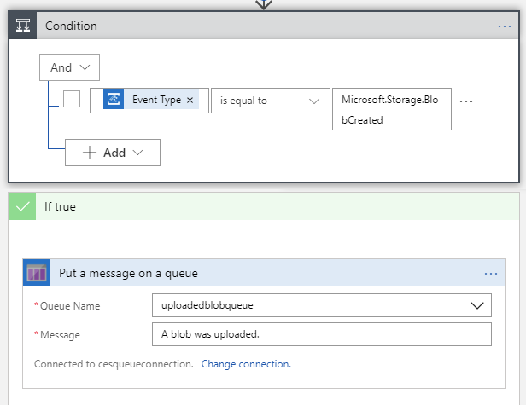
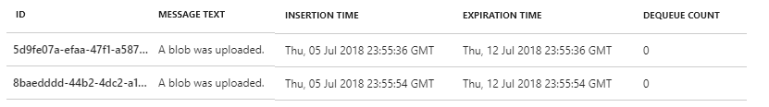
Implementing Event Grid (Part 2)
Implementation steps (part 2):
6. Edit the Logic App:
One condition: True whenever a blob is created
One action: Add a message to the queue.
7. Save changes and start the Logic App
8. Create an storage container and upload a blob
9. View messages in the Storage queue
10. To avoid future charges, delete all resources

Slide 27
Practice: Event Grid

Slide 28
Video: Getting Started with Logic Apps
Notes:
Do the twitter demo...
Retweet about a spesific content if it is tweeted... Or trigger something else..

